Slide 1
RDBMS and MySQL - Assignment I
By: Rishika Kumari
1852

Slide 2
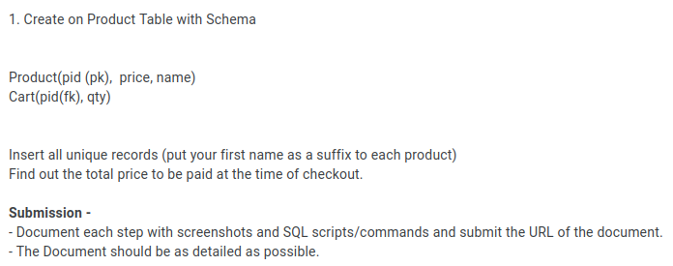
Question 1:

Slide 3

Creating database:

Slide 4
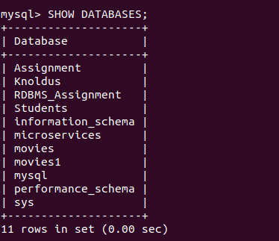
Showing all the available databases:

Slide 5

Selection of the database:

Slide 6
Creating Table : Product

Slide 7
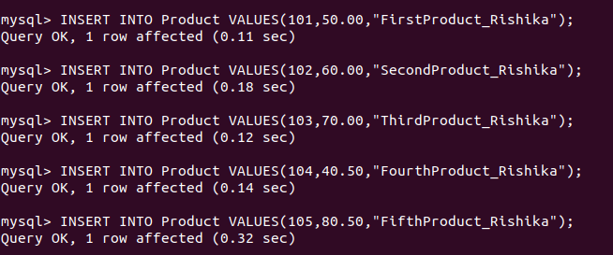
Inserting values into Product table:

Slide 8
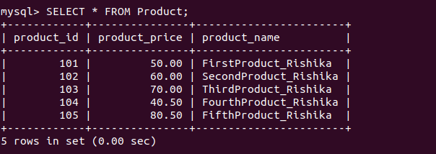
Showing the records of Product table:

Slide 9
Creating another table named as, Cart (contains two attributes product_id & quantity).
Note:
Creating another table named as Cart and assigning product_id as a foreign key for the Cart table.

Slide 10

Inserting values into Cart table:

Slide 11
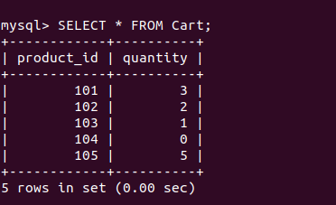
Showing the records of the Cart table:

Slide 12
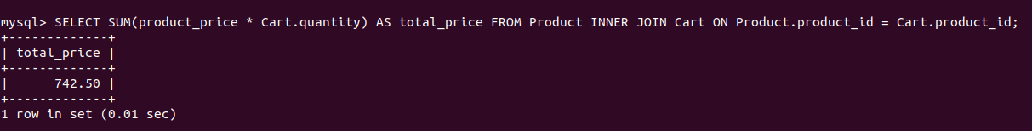
Calculating the total price to be paid at the time of checkout:
NOTE:
SELECT SUM(product_price * Cart.quantity) AS total_price FROM Product INNER JOIN Cart ON Product.product_id = Cart.product_id;

Slide 13
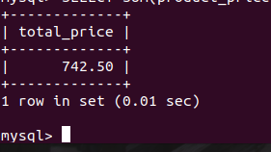
The total price to be paid at the checkout time is:

Slide 14
THANK YOU!

